Slide 1
Marketing Coverage
Each customer will have an account manager.
Deals/Customers will be segmented by customer interaction and product needs. The segments are:
  Transactional
  Services
  Development
Each segment will have a team lead or “coordinator” responsible for product development and uniformity and achieving 2001 segment goals.
Integrate power and gas product slate for efficient coverage.

Slide 2
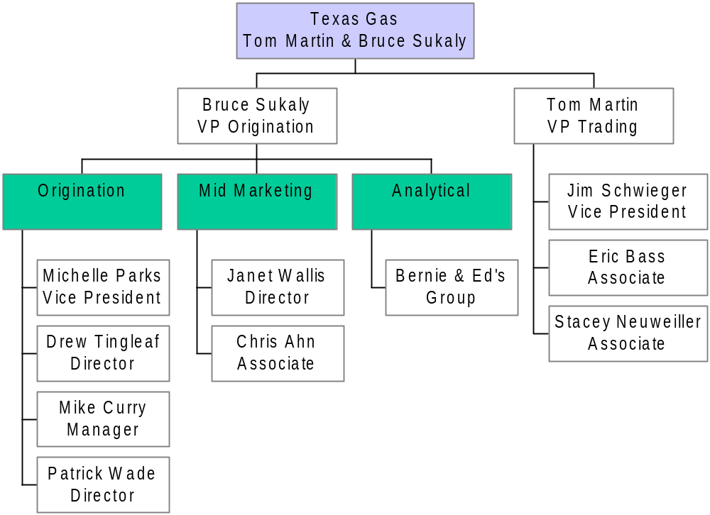
TEXAS Gas Team

Slide 3
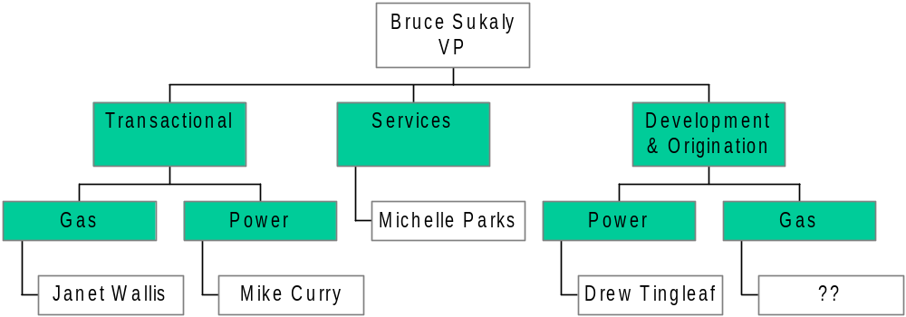
TEXAS Marketing Segment Responsibilities

Slide 4
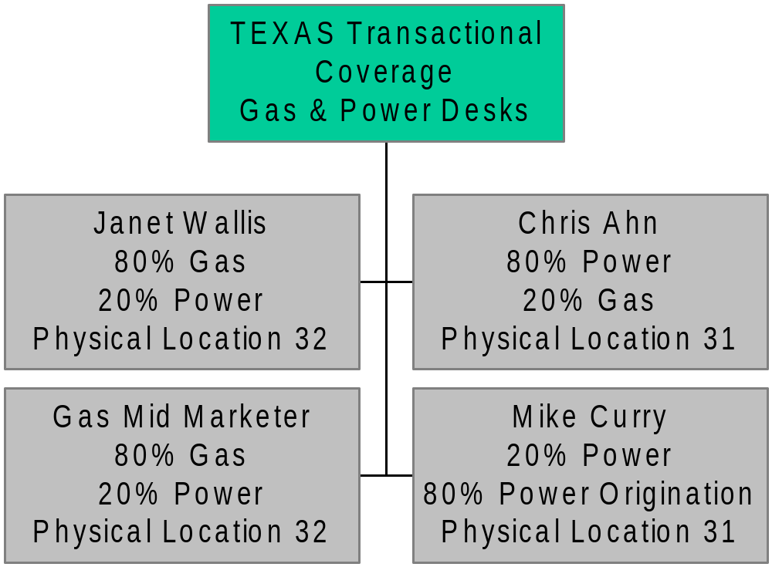
Transactional Coverage & Logistics

